Slide 1
Lecture 6 CUDA Global Memory
Kyu Ho Park
Mar. 21, 2017

Slide 2
Performance Tuning
To optimize the bandwidth utilization of a device,
-Aligned and coalesced memory access,
-Sufficient concurrent memory operations are required.
To increase the concurrent memory access,
-Increasing the number of independent memory operations performed in each thread,
-kernel launch should be configured to get efficient parallelism.

Slide 3
Parallelism
Task Parallelism:
It focuses on distributing functions across multiple cores.
Data Parallelism:
It focuses on distributing the data across multiple cores.
Data Partitions:
1.Block Partition:
Each thread takes one portion of data.
2.Cyclic Partition:
Each thread takes more than one portion
of the data.

Slide 4
Latency Hiding
Instruction Latency: the number of clock cycles between an instruction being issued and being completed.
Latency:
Arithmetic operations: 10~20 cycles
Global Memory Access: 400~800 cycles.

Slide 5
Little’s Law
L = λW, where
λ : longterm average effective arrival rate,
W : average time a customer spends in the system.
Number of Required Warps
=Throughput x Latency.
In pipeline, L (operations) = λ (IPC) W (instruction latency)

Slide 6
SM Parallelism Required to Maintain Full Arithmetic Utilization
GPU Model | Instruction Latency (Cycles) | Throughput (Operations/Cycle) | Parallelism (Operations)
Fermi | 20 | 32 | 640
Kepler | 20 | 192 | 3,830

Slide 7
Device Parallelism Required to Maintain Full Memory Utilization
GPU Model | Memory Instruction Latency(Cycles) | Bandwidth (GB/Sec) | Bandwidth (Bytes/Cycle) | Parallelism (KB)
Fermi | 800 | 144 | 92 | 74
Kepler | 800 | 250 | 96 | 77
Fermi TeslaC2070: Memory frequency: 1.566GHz

Slide 8
Unrolling a loop in C
CVCV
//Normal Loop
int i;
for( i=0;i<100;i++)
{
function(i);
}
//Unrolled Loop
int i;
for( i=0; i<100; i+=4)
{
function( i );
function(i+1);
function(i+2);
function(i+3);
}
number of compare reduces ¼
give 4 concurrency operation

Slide 9
Advantage of the unrolling loop?
In the unrolled loop, the condition i<100 is only checked 25 times instead of 100 times.
The reads and writes performed in each statement of each loop are independent, the memory operations can be issued simultaneously by the CPU.
Unrolling in CUDA, more concurrent operations are added to the pipeline leading to higher saturation of instruction and memory bandwidth. This provides the warp scheduler with more eligible warps that can help hide instruction or memory latency.

Slide 10
Perforemance Tuning:Unrolling loops
__global__ void readOffset(float *A, float *B, float *C, const int n, int offset) {
unsigned int i=blockIdx.x * blockDim.x + threadIdx.x;
unsigned int k= i + offset;
if( k<n) C[i] =A[k] + B[k];
}
__global__ void readOffsetUnroll4(float *A, float *B, float *C, const int n,
int offset){
unsigned int i=blockIdx.x*blockDim.x *4 + threadIdx.x;
if(k+3*blockDim.x<n) {
C[i]=A[k] +B[k];
C[i + blockDim.x] =A[k+blockDim.x] + B[k+blockDim.x];
C[i+ 2*blockDim.x]=A[k+2*blockDim.x]+B[k+2*blockDim.x];
C[i+ 3*blockDim.x]=A[k+3*block*Dim.x]+B[k+3*blockDim.x];
}
}

Slide 11
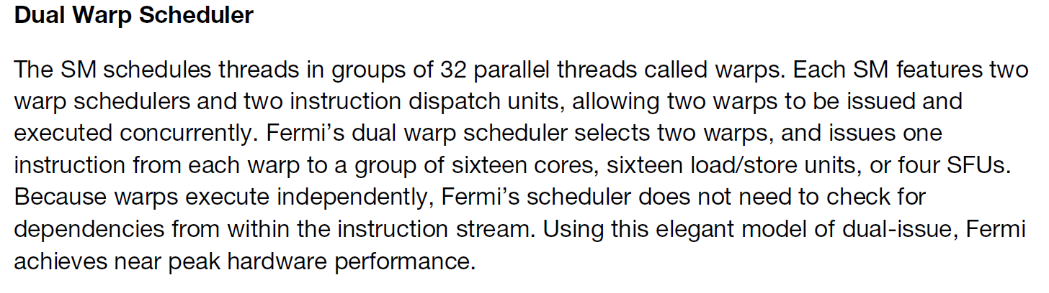
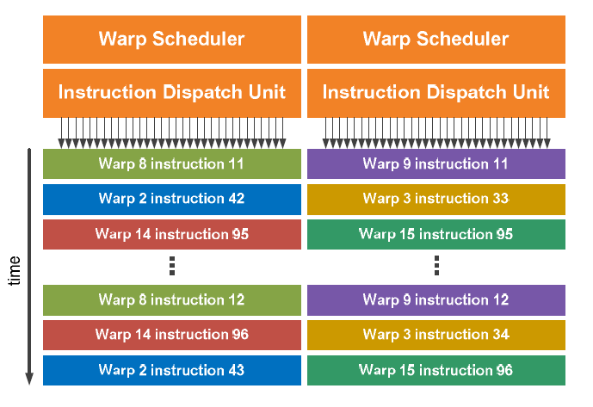

Slide 12
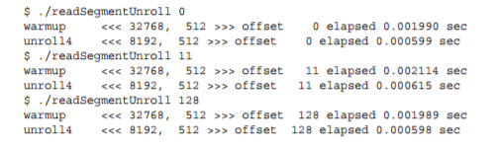
L1 cache enabled Performance

Slide 13
Matrix Transpose
0 | 4 | 8
1 | 5 | 9
2 | 6 | 10
3 | 7 | 11
0 | 1 | 2 | 3
4 | 5 | 6 | 7
8 | 9 | 10 | 11
Matrix
Transposed Matrix

Slide 14
Data Layout of Matrices
original matrix ( can be aligned, coalesced O)
0 | 1 | 2 | 3 | 4 | 5 | 6 | 7 | 8 | 9 | 10 | 11
transposed matrix ( can be aligned, Coalesced X)
0 | 4 | 8 | 1 | 5 | 9 | 2 | 6 | 10 | 3 | 7 | 11
void transposeHost(float *out, float *in,const int nx, const int ny){
for(int iy=0; iy<ny; ++iy){
for(int ix=0; ix<nx;++ix){
out[ix*ny + iy]=in[iy*nx+ix];
}
}
}

Slide 15
Read: by rows in the matrix, coalesced access.
Write: by columns in the transposed matrix, stride access which is the worst memory access pattern.
How to improve the bandwidth utilization:
Two approaches:
1.Read by rows and write by columns,
2.Read by columns and write by rows.

Slide 16
read by row, write by column
ix
nx
iy
ny
ix
(iy,ix)
iy
(ix,iy)
ix=blockIdx.x*blockDim.x +
threadIdx.x,
iy=blockIdx.y*blockDim.y +
threadIdx.y
ny
nx
Transposed Matrix
Matrix

Slide 17
Matrix Transpose
0 (0,0) | 4 (0,1) | 8 (0,2)
1 (1,0) | 5 (1,1) | 9 (1,2)
2 (2,0) | 6 (2,1) | 10 (2,2)
3 (3,0) | 7 (3,1) | 11 (3,2)
0 (0,0) | 1 (1,0) | 2 (2,0) | 3 (3,0)
4 (0,1) | 5 (1,1) | 6 (2,1) | 7 (3,1)
8 (0,2) | 9 (1,2) | 10 (2,2) | 11 (3,2)
(ix,iy)
Matrix
(iy,ix)
Transposed Matrix

Slide 18
Transpose: Read in Row and Write in Column
__global__ void transposeRow(float *out, float *in, const int nx, const int ny){
unsigned int ix=blockDim.x*blockIdx.x+threadIdx.x;
unsigned int iy=blockDim.y*blockIdx.y+threadIdx.y;
if(ix < nx && iy<ny){
out[ix*ny + iy]= in[iy*nx + ix];
}
}

Slide 19
read by column, write by row
ix
nx
iy
ny
ix
(ix,iy)
iy
(iy,ix)
iy=blockIdx.y*blockDim.y +
threadIx.y,
ix=blockIdx.x*blockDim.x +
threadIdx.x
ny
nx
Transposed Matrix
Matrix

Slide 20
Matrix Transpose
0 (0,0) | 4 (0,1) | 8 (0,2)
1 (1,0) | 5 (1,1) | 9 (1,2)
2 (2,0) | 6 (2,1) | 10 (2,2)
3 (3,0) | 7 (3,1) | 11 (3,2)
0 (0,0) | 1 (0,1) | 2 (0,2) | 3 (0,3)
4 (1,0) | 5 (1,1) | 6 (1,2) | 7 (1,3)
8 (2,0) | 9 (2,1) | 10 (2,2) | 11 (2,3)
(iy,ix)
(ix,iy)
Matrix
Transposed Matrix

Slide 21
Transpose Read by Column and Write by Row
__global__ void transposeCol(float *out, float *in, const int nx, const int ny){
unsigned int ix=blockDim.x*blockIdx.x+threadIdx.x;
unsigned int iy=blockDim.y*blockIdx.y+threadIdx.y;
if(ix < nx && iy<ny){
out[iy*nx + ix]= in[ix*ny + iy];
}
}

Slide 22
Upper and Lower Performance Bound
Upper Bound (best, may be memory bandwidth): Copy the matrix by loading and storing rows, which are all coalesced accesses.
The number of memory operations is the same
as that of the matrix transpose.
Lower Bound (worst, may be memory bandwidth): Copy the matrix by loading and storing columns, which are all stride accesses.
The number of memory operations is the same
as that of the matrix transpose.

Slide 23
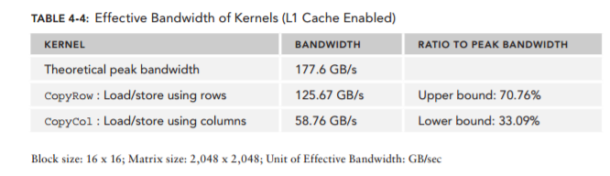

Slide 24
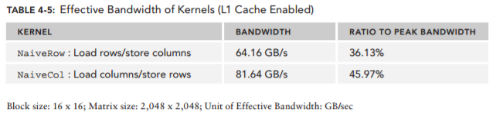
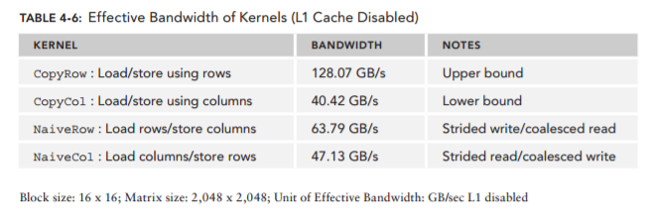
cpu L1 : temporal & spatial locality
gpu L1 : spatial locality

Slide 25
Unrolling Transpose
To improve the memory bandwidth of transpose, the unrolling transpose is to assign more independent work to each thread in order to maximize in-flight memory requests.

Slide 26
Row-based unrolling
__global__ void transposeNaive4Row(float *out, float *in, const int nx, const int ny){
unsigned int ix=blockDim.x*blockIdx.x+threadIdx.x;
unsigned int iy=blockDim.y*blockIdx.y+threadIdx.y;
unsigned int ti=iy*nx+ix;
unsigned int to=ix*ny+iy;
if(ix+3*blockDim.x < nx && iy<ny){
out[to]= in[ti];
out[to+ny*blockDim.x]=in[ti+blockDim.x];
out[to+ny*2*blockDim.x]=in[ti+2*blockDim.x];
out[to+ny*3*blockDim.x]=in[ti+3*blockDim.x];
}
}

Slide 27
Column-based Unrolling
__global__ void transposeNaive4Col(float *out, float *in, const int nx, const int ny){
unsigned int ix=blockDim.x*blockIdx.x+threadIdx.x;
unsigned int iy=blockDim.y*blockIdx.y+threadIdx.y;
unsigned int ti=iy*nx+ix;
unsigned int to=ix*ny+iy;
if(ix+3*blockDim.x < nx && iy<ny){
out[ti]= in[to];
out[ti+ny*blockDim.x]=in[to+blockDim.x];
out[ti+ny*2*blockDim.x]=in[to+2*blockDim.x];
out[ti+ny*3*blockDim.x]=in[to+3*blockDim.x];
} }

Slide 28
Diagonal Transpose
Cartesian Coordinate
(0,0) 0 | (1,0) 1 | (2,0) 2 | (3,0) 3
(0,1) 4 | (1,1) 5 | (2,1) 6 | (3,1) 7
(0,2) 8 | (1,2) 9 | (2,2) 10 | (3,2) 11
(0,3) 12 | (1,3) 13 | (2,3) 14 | (3,3) 15
(blockIdx.x , blockIdx.y)
int bid=blockIdx.y*gridDim.x + blockIdx.x;

Slide 29
Diagonal Transpose
Diagonal Coordinate
(0,0) 0 | (0,1) 4 | (0,2) 8 | (0,3) 12
(1,3) 13 | (1,0) 1 | (1,1) 5 | (1,2) 9
(2,2) 10 | (2,3) 14 | (2,0) 2 | (2,1) 6
(3,1) 7 | (3,2) 11 | (3,3) 15 | (3,0) 3
(blockIdx.x , blockIdx.y)
blockIdx.y shift to right circularly
int bid=blockIdx.y*gridDim.x + blockIdx.x;
Transformation from the Diagonal Coordinate( blockIdx.x, blockIdx.y)
to the Cartesian Coordinate ( block_x, block_y):
block.x=(blockIdx.x+blockIdx.y)%gridDim.x;
block.y=blockIdx.x;

Slide 30
Partition Camping
(0,0) 0 | (1,0) 1 | (2,0) 2 | (3,0) 3
(0,1) 4 | (1,1) 5 | (2,1) 6 | (3,1) 7
(0,2) 8 | (1,2) 9 | (2,2) 10 | (3,2) 11
(0,3) 12 | (1,3) 13 | (2,3) 14 | (3,3) 15
0 | 4 | 8 | 12
1 | 5 | 9 | 13
2 | 6 | 10 | 14
3 | 7 | 11 | 15
IN Data
OUT Data

Slide 31
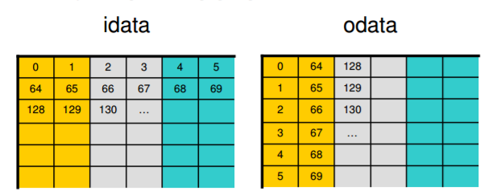
Partition Camping
Greg Ruetsch and Paulis Micikevicius,
“Optimizing Matrix Transpose in CUDA,”
NVIDIA.

Slide 32
Diagonal Coordinate
0 | 4 | 8 | 12
13 | 1 | 5 | 9
10 | 14 | 2 | 6
7 | 11 | 15 | 3
0 | 13 | 10 | 7
4 | 1 | 14 | 11
8 | 5 | 2 | 15
12 | 9 | 6 | 3
IN Data
OUT Data

Slide 33
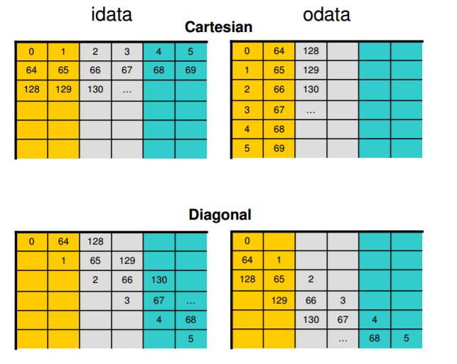
Greg Ruetsch and Paulis Micikevicius,
“Optimizing Matrix Transpose in CUDA,”
NVIDIA.

Slide 34
More Parallelism with Thin Blocks
nx
ny
ny
nx

Slide 35
More Parallelism with Thin Blocks
For the case ‘transposeNaiveCol’ with GTX970
Block Size | Bandwidth(GB/s)
(32,32) | 72.32
(32,16) | 51.46
(32,8) | 77.67
(16,32) | 113.04
(16,16) | 111.08
(16,8) | 82.01
(8,32) | 127.60
(8,16) | 112.59
(8,8) | 73.72

Slide 36
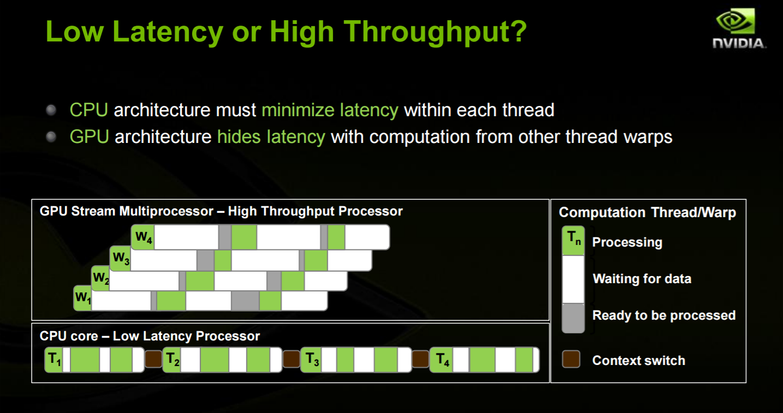

Slide 37
Presentation on Mar. 30, 2017
강상훈
NVIDIA Profiler User’s Guide, NVIDIA
김혜지
Greg Ruetsch and Paulis Micikevicius,
“Optimizing Matrix Transpose in CUDA,”
NVIDIA.

Slide 38


